Slide 1
Research Report
Vo Khoi Thanh Son
14-6-2024

Slide 2
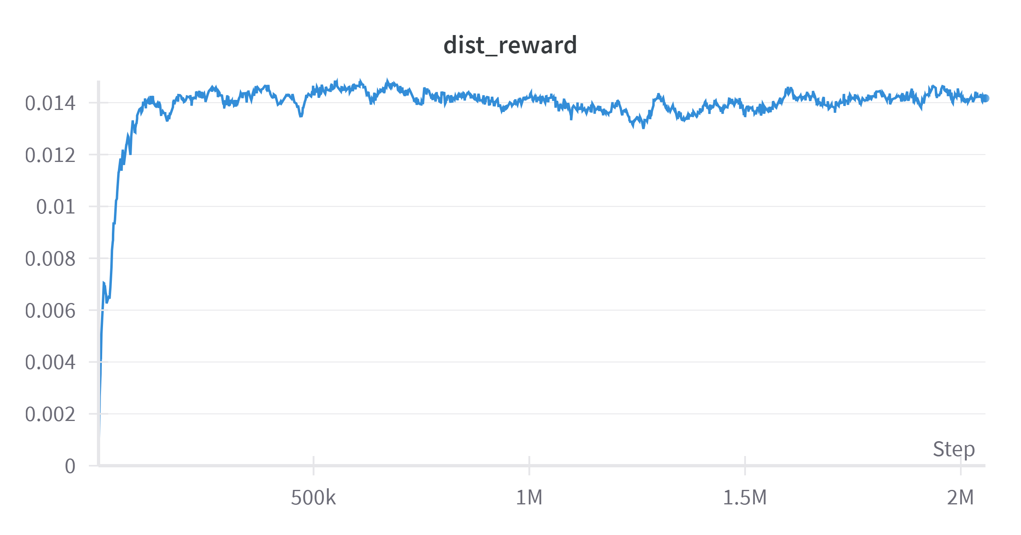
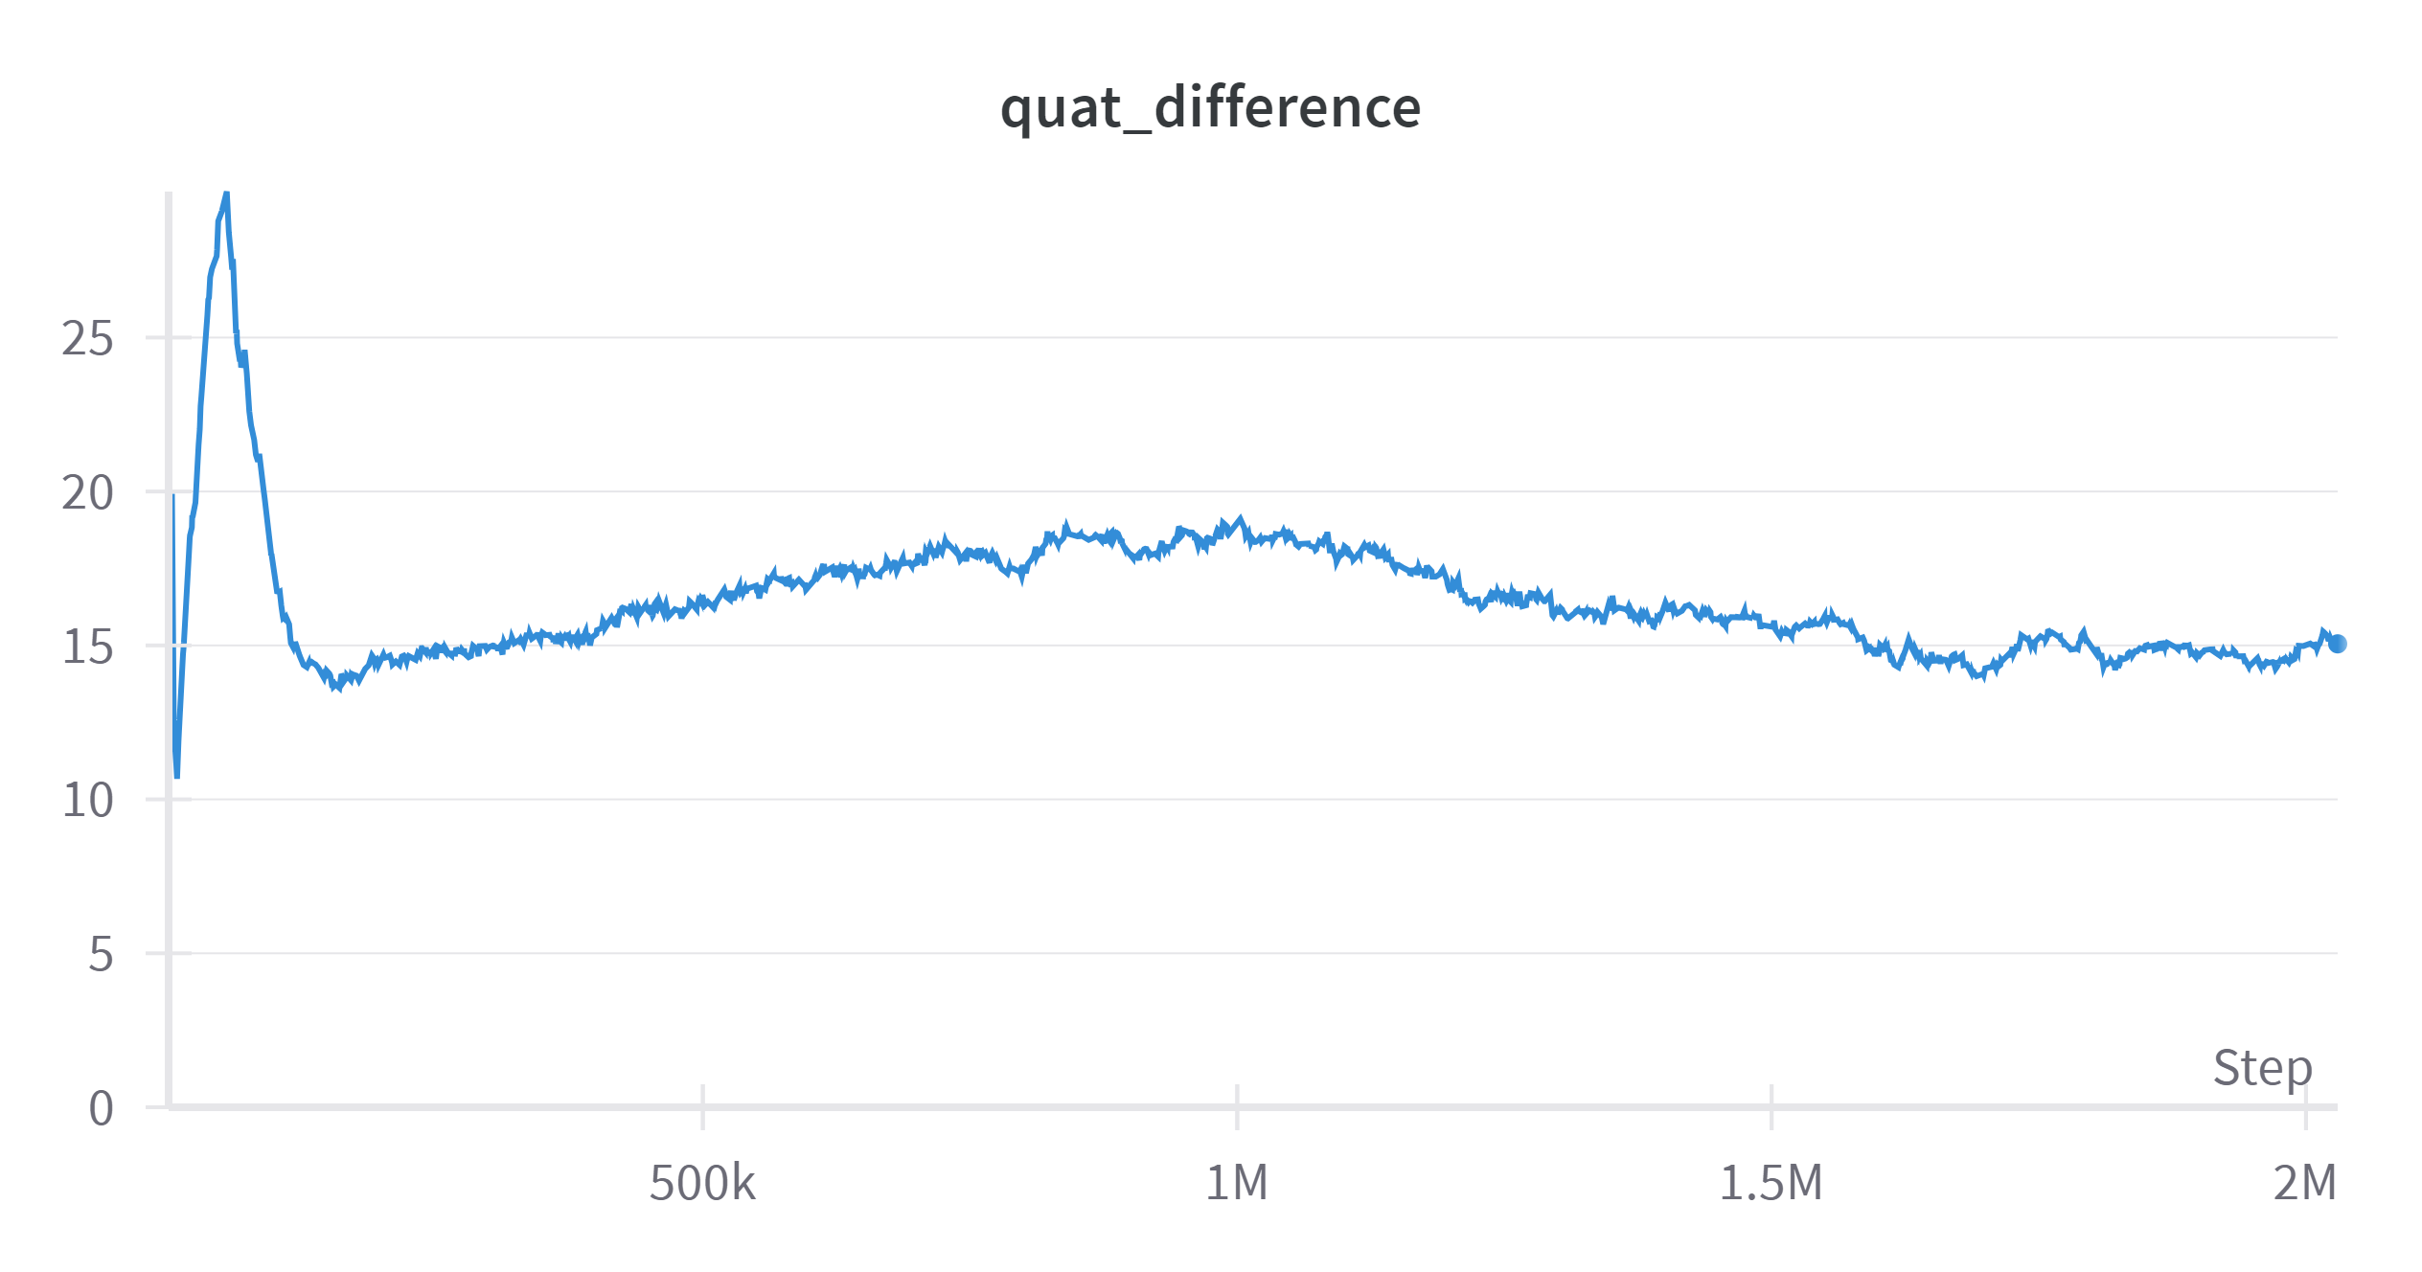
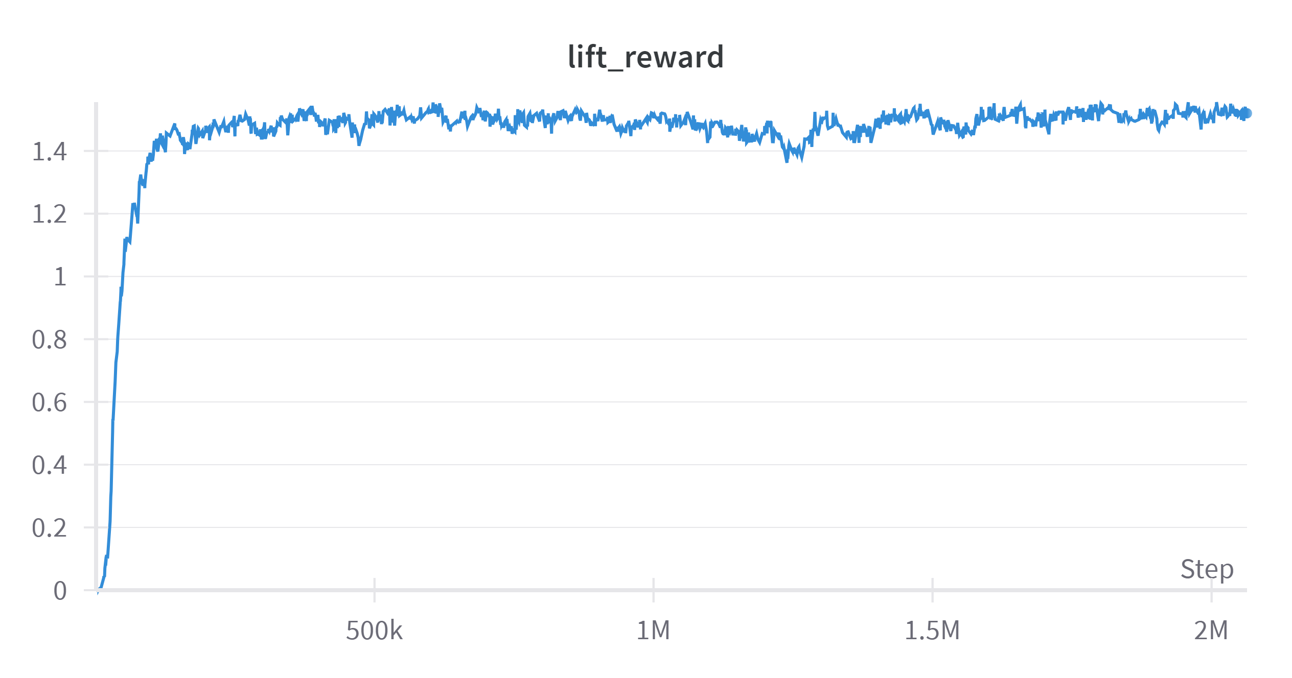
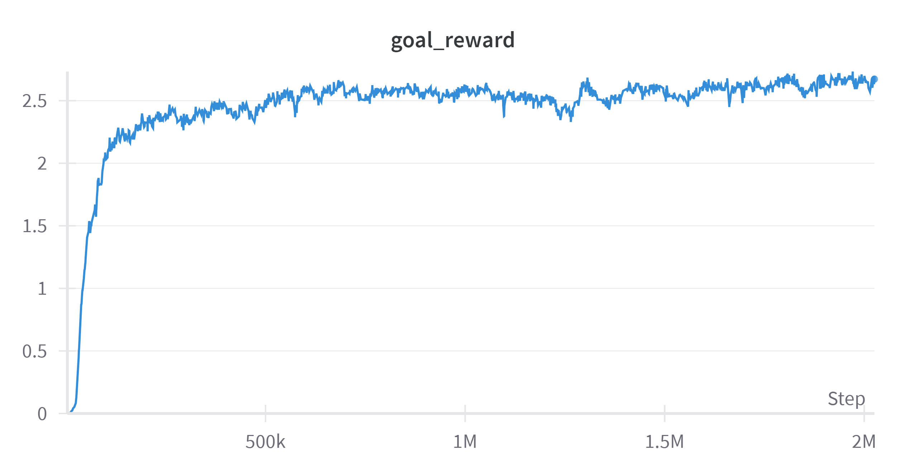
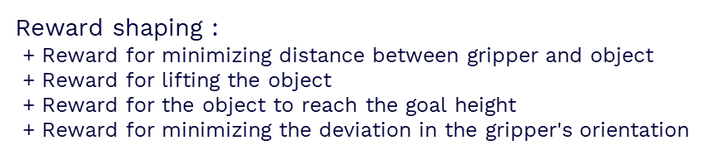
Previous work
Training the teacher policy to grasp objects with different types of soft grippers
- Improve the reward function for stable grasping
Reward shaping :
+ Reward for minimizing distance between gripper and object
+ Reward for lifting the object
+ Reward for the object to reach the goal height
+ Reward for minimizing the deviation in the gripper's orientation
→ Verify the individual reward for grasping
→ Improvement on fixing the orientation of the gripper

Slide 3
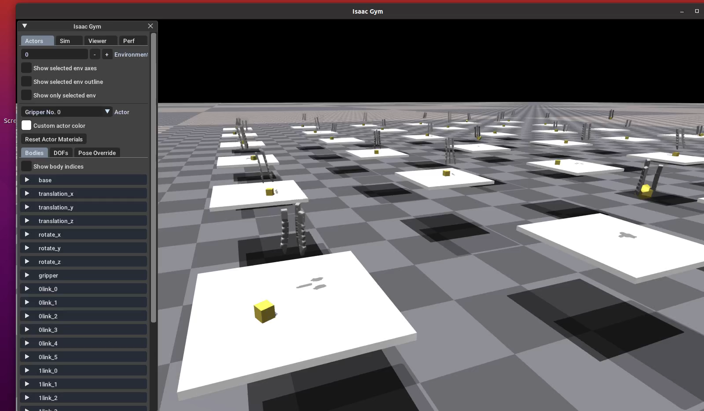
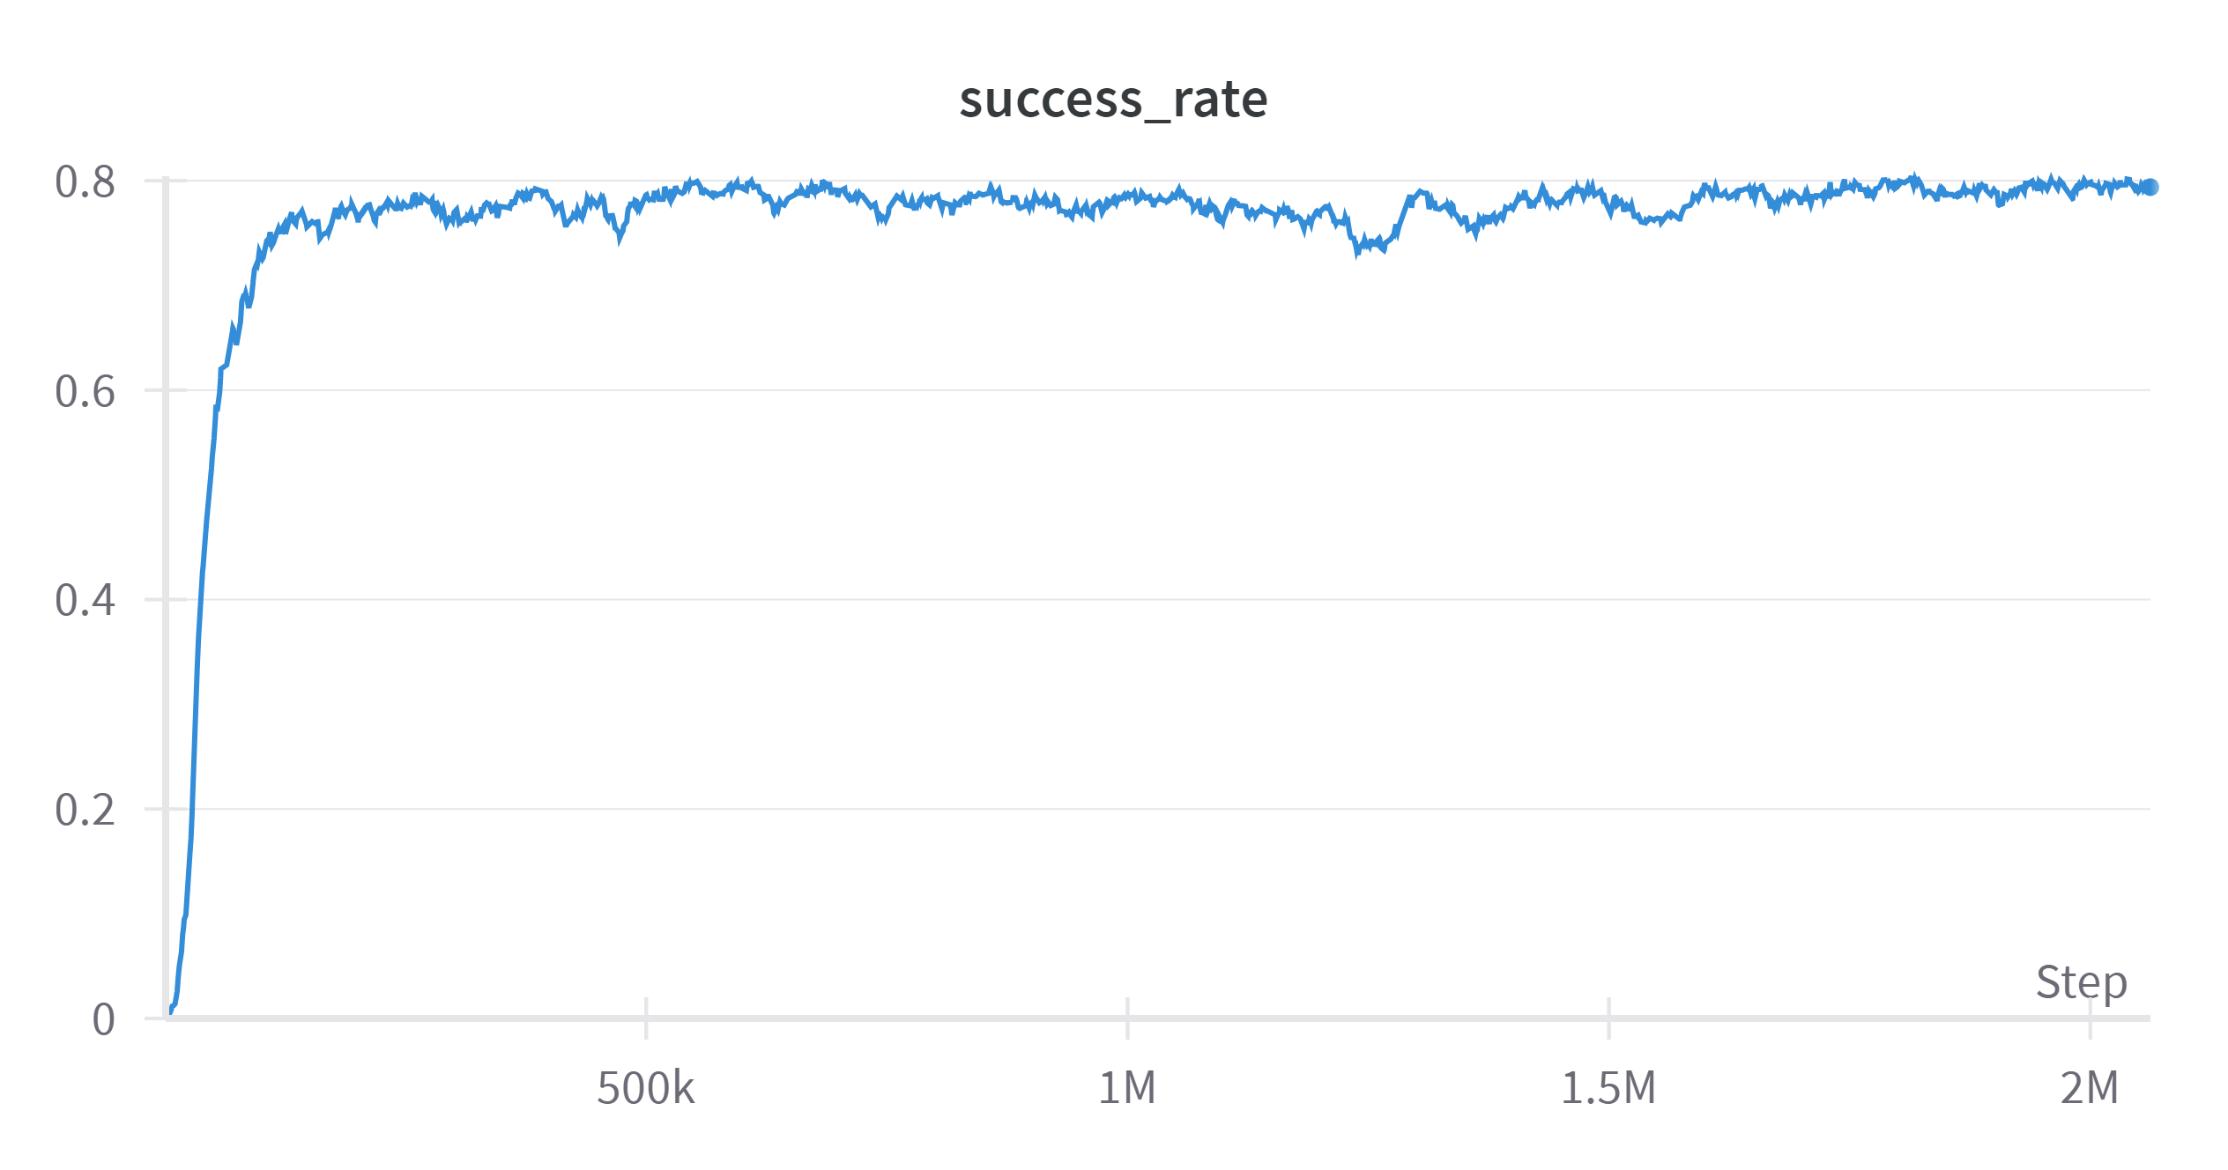
Gripper performance
- Success rate is defined by the object reaching the target height
Video

Slide 4
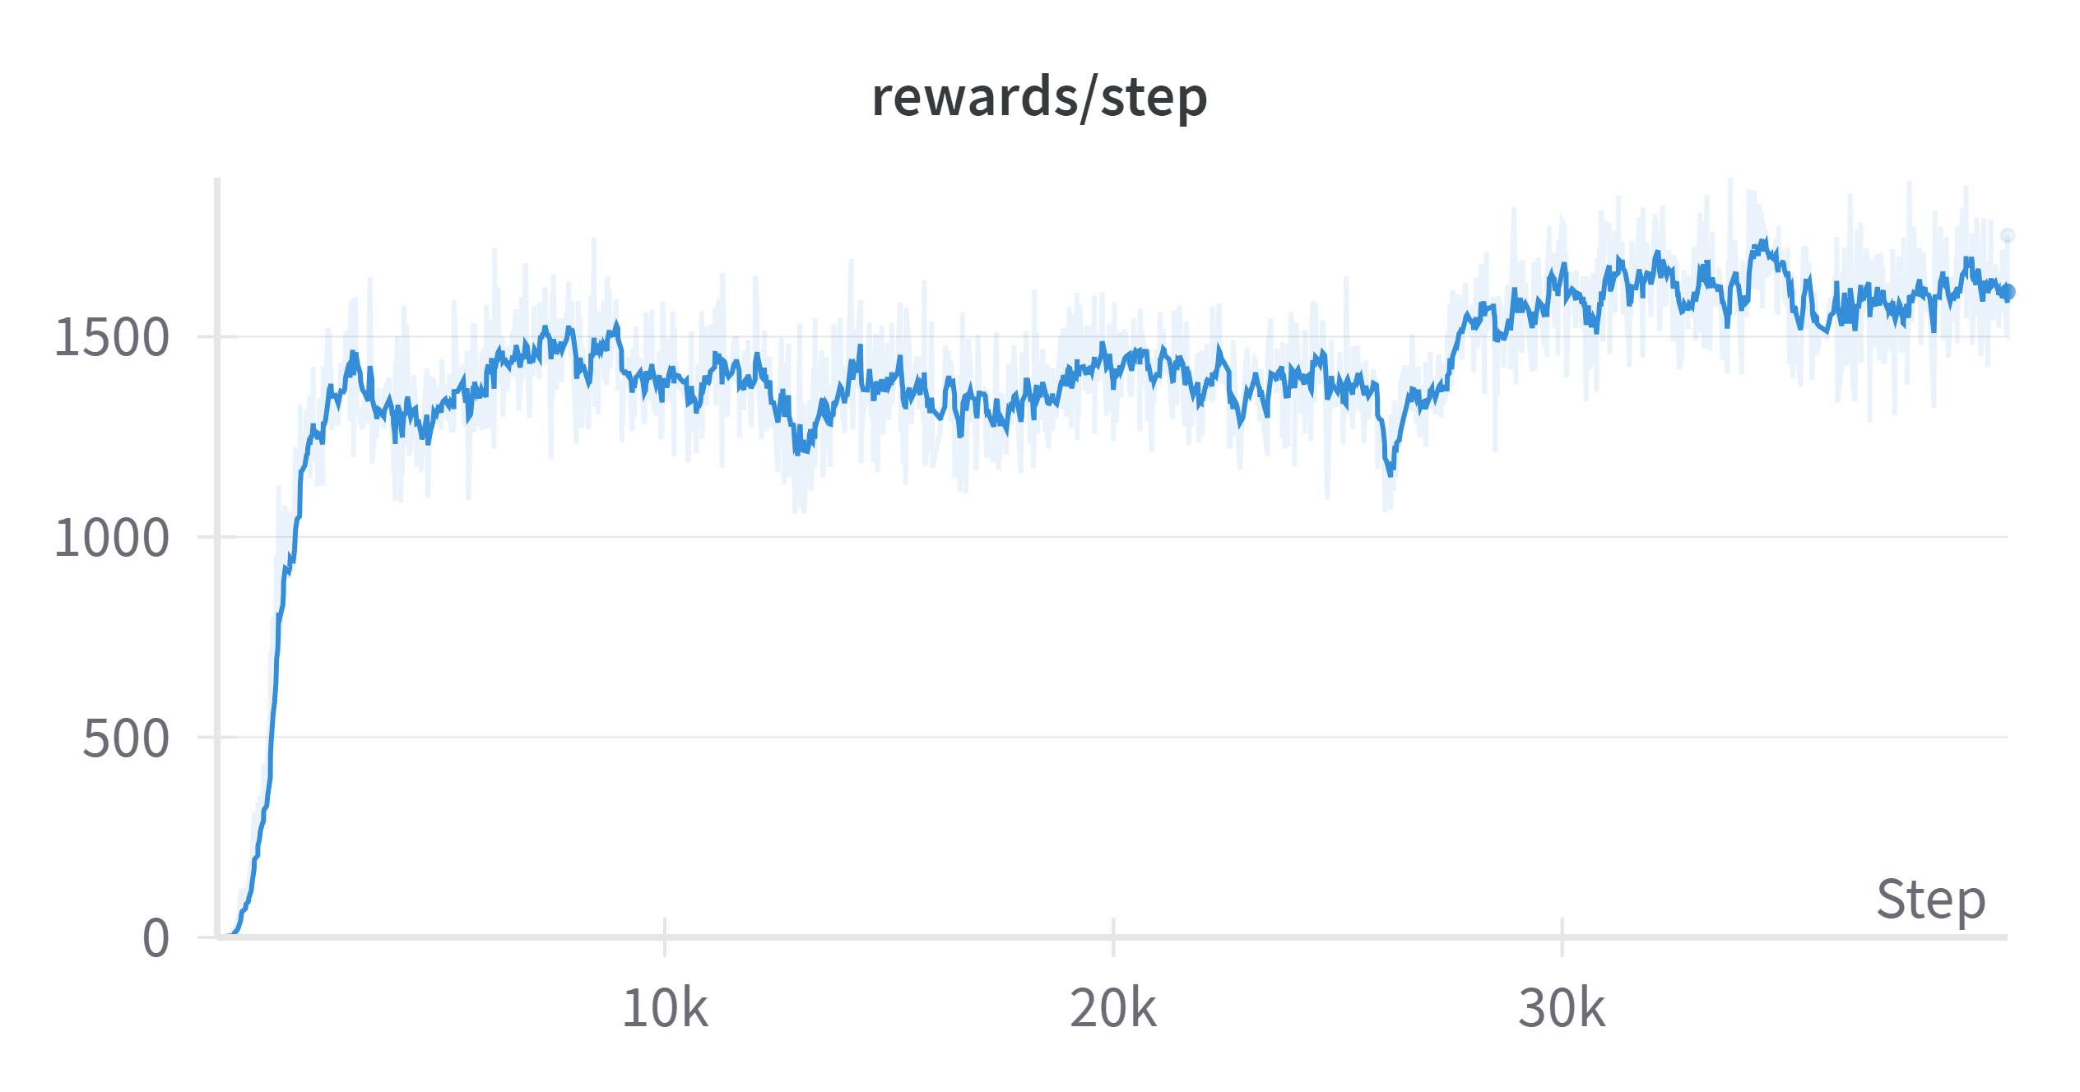
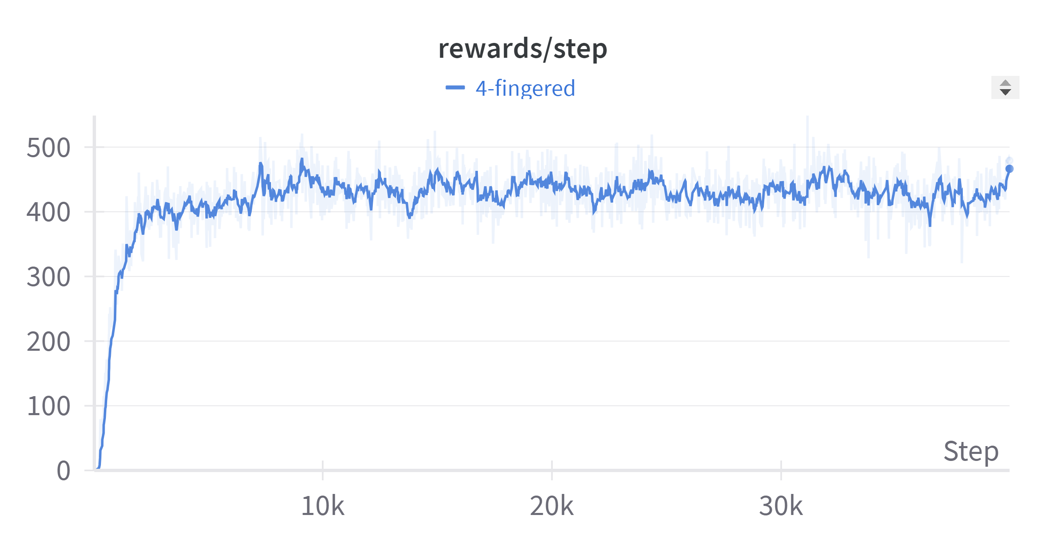
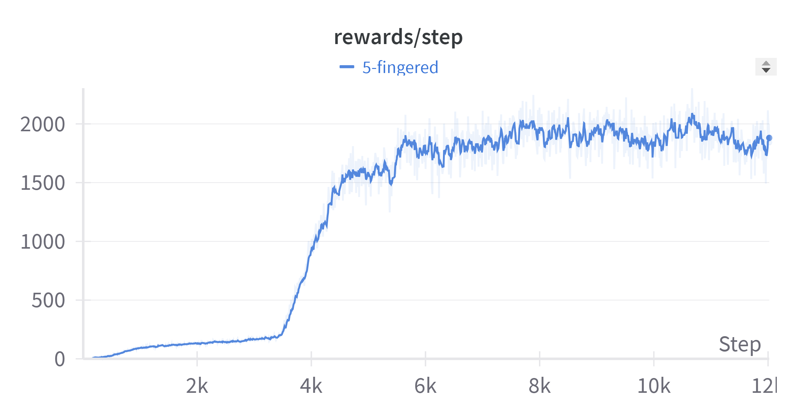
Gripper performance
3-fingered gripper
4-fingered gripper
Performance of different gripper types with 1 object
→ Performance decreases when training with bigger objects
5-fingered gripper

Slide 5
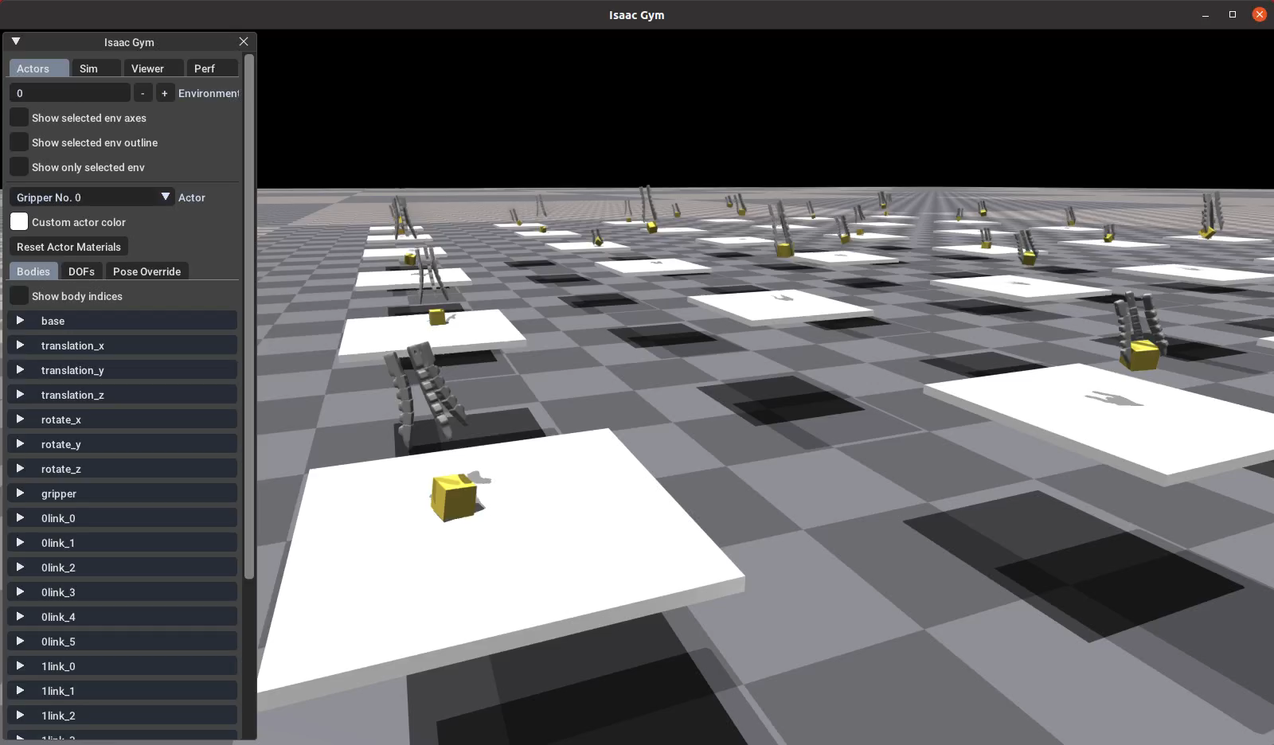
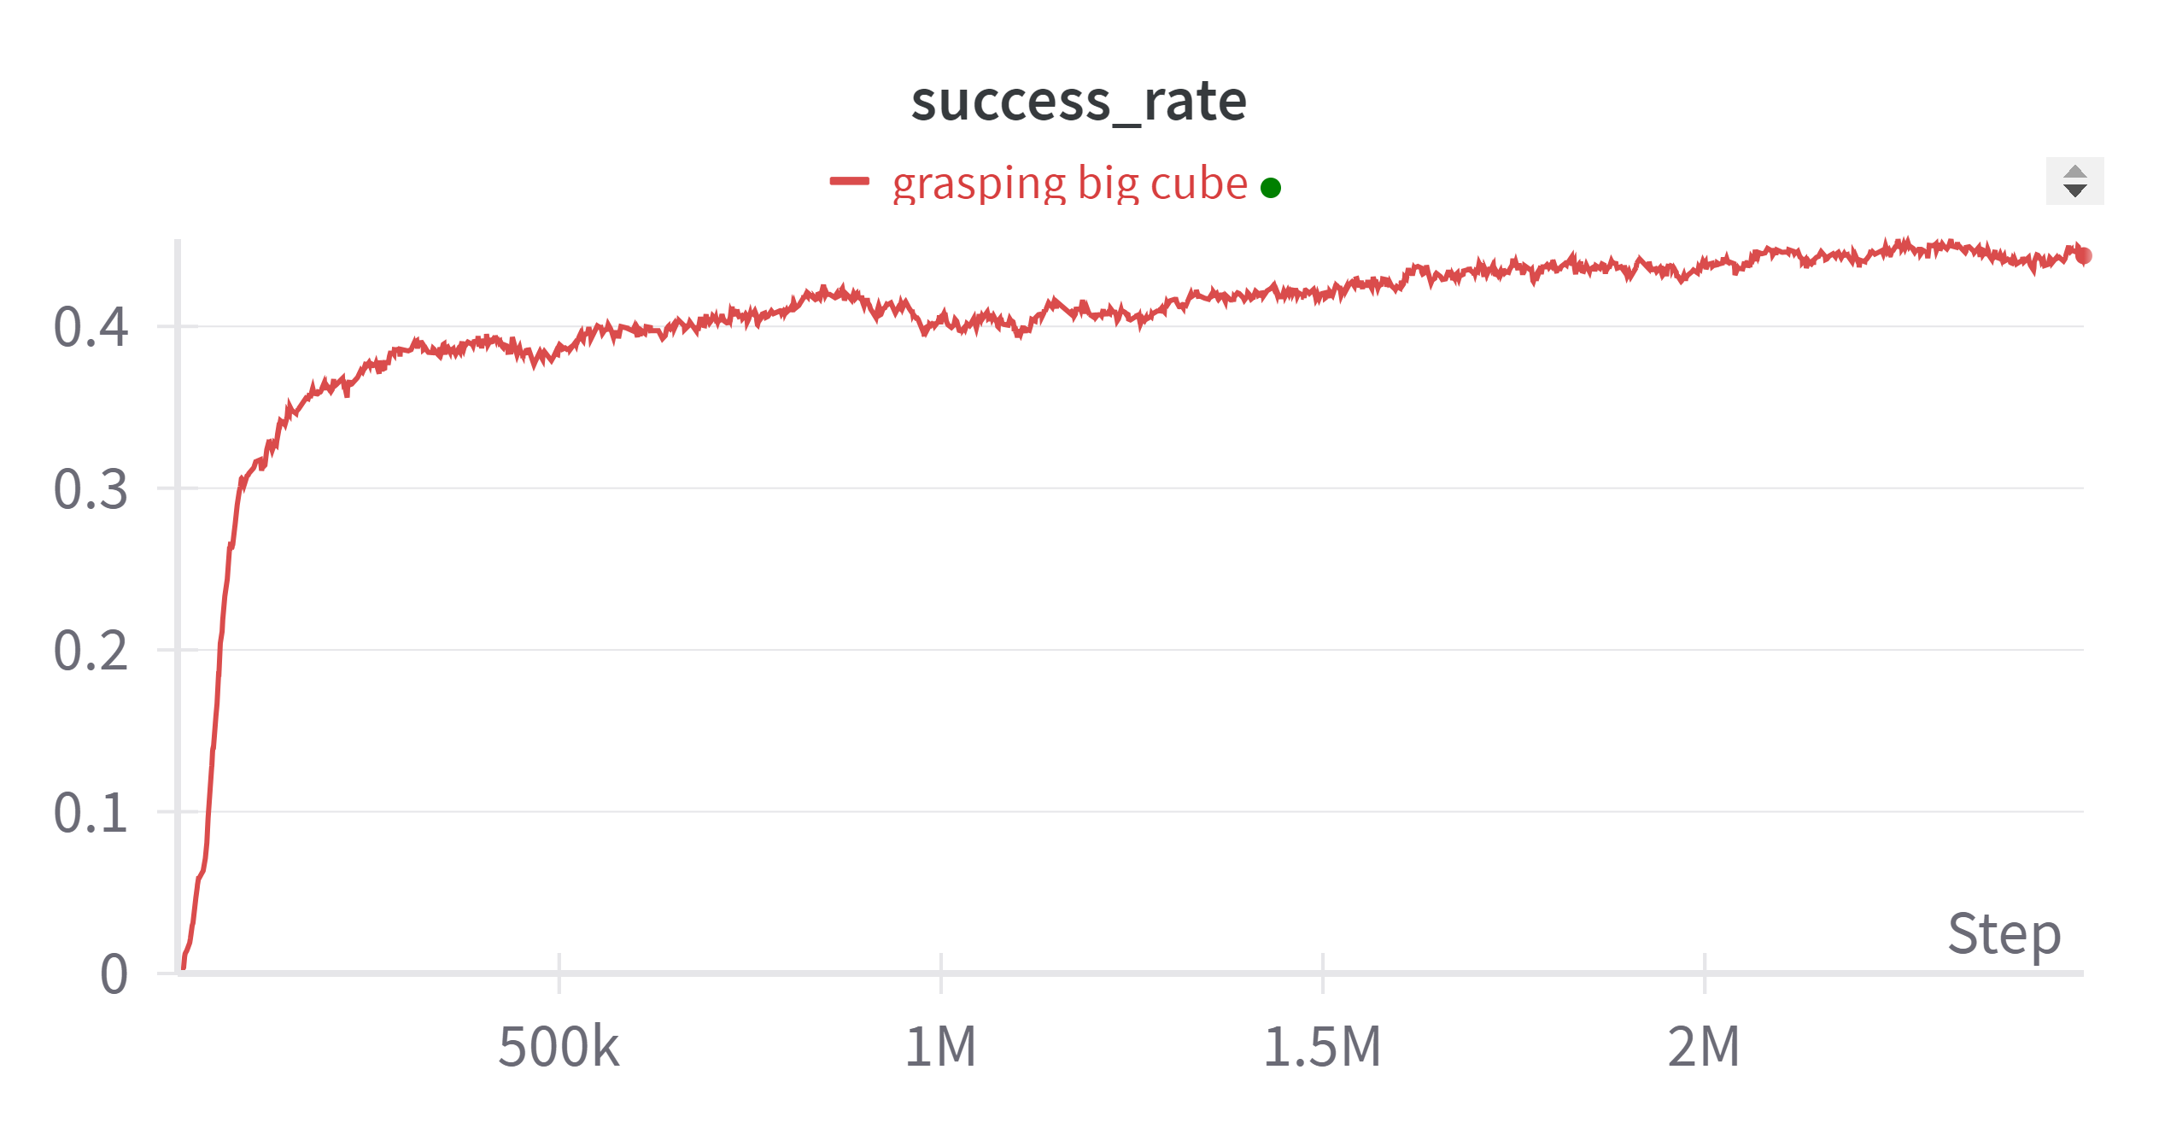
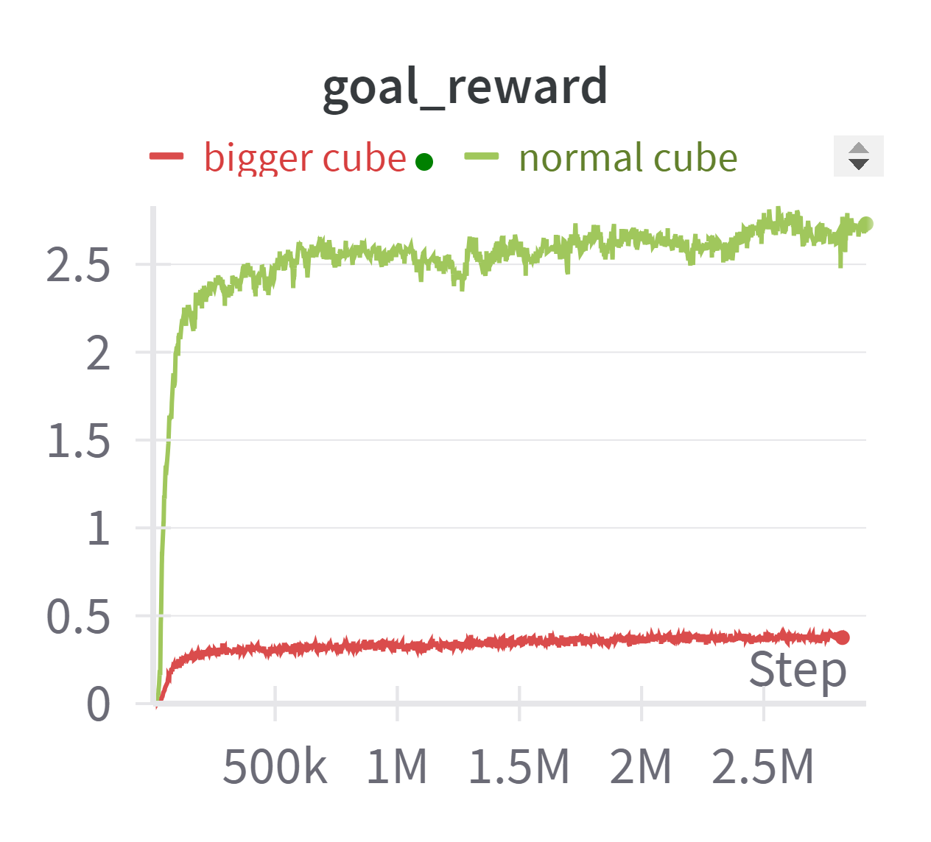
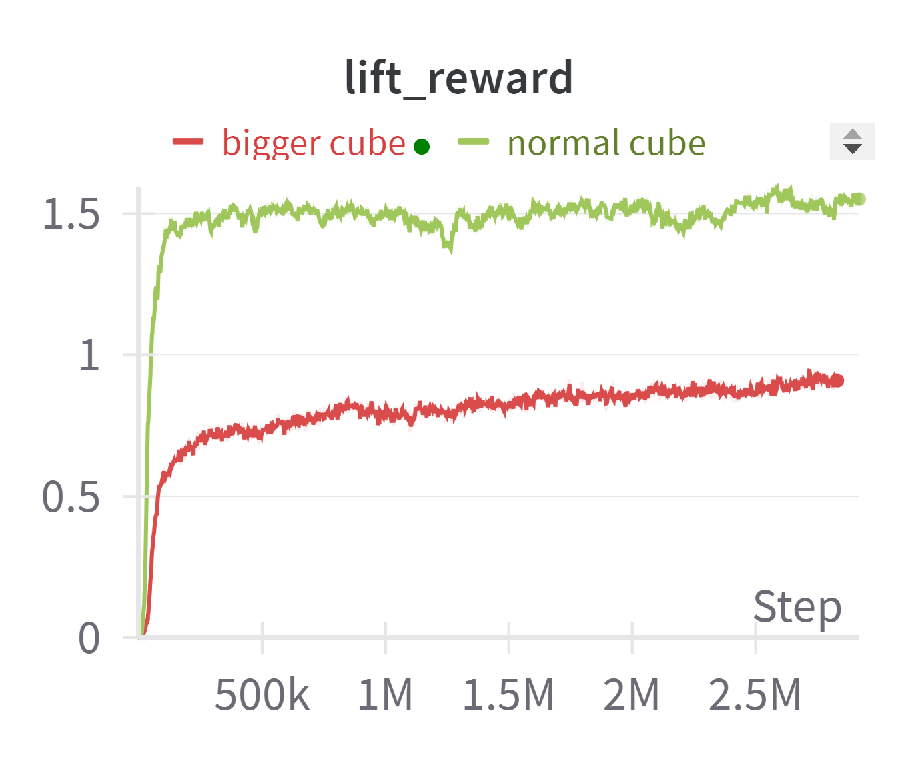
Gripper performance
Performance with big object
- Bigger object frequently drops while lifting, not reaching the target height
- Lower success rate
→ Need more adjustment
Success rate for grasping bigger object

Slide 6
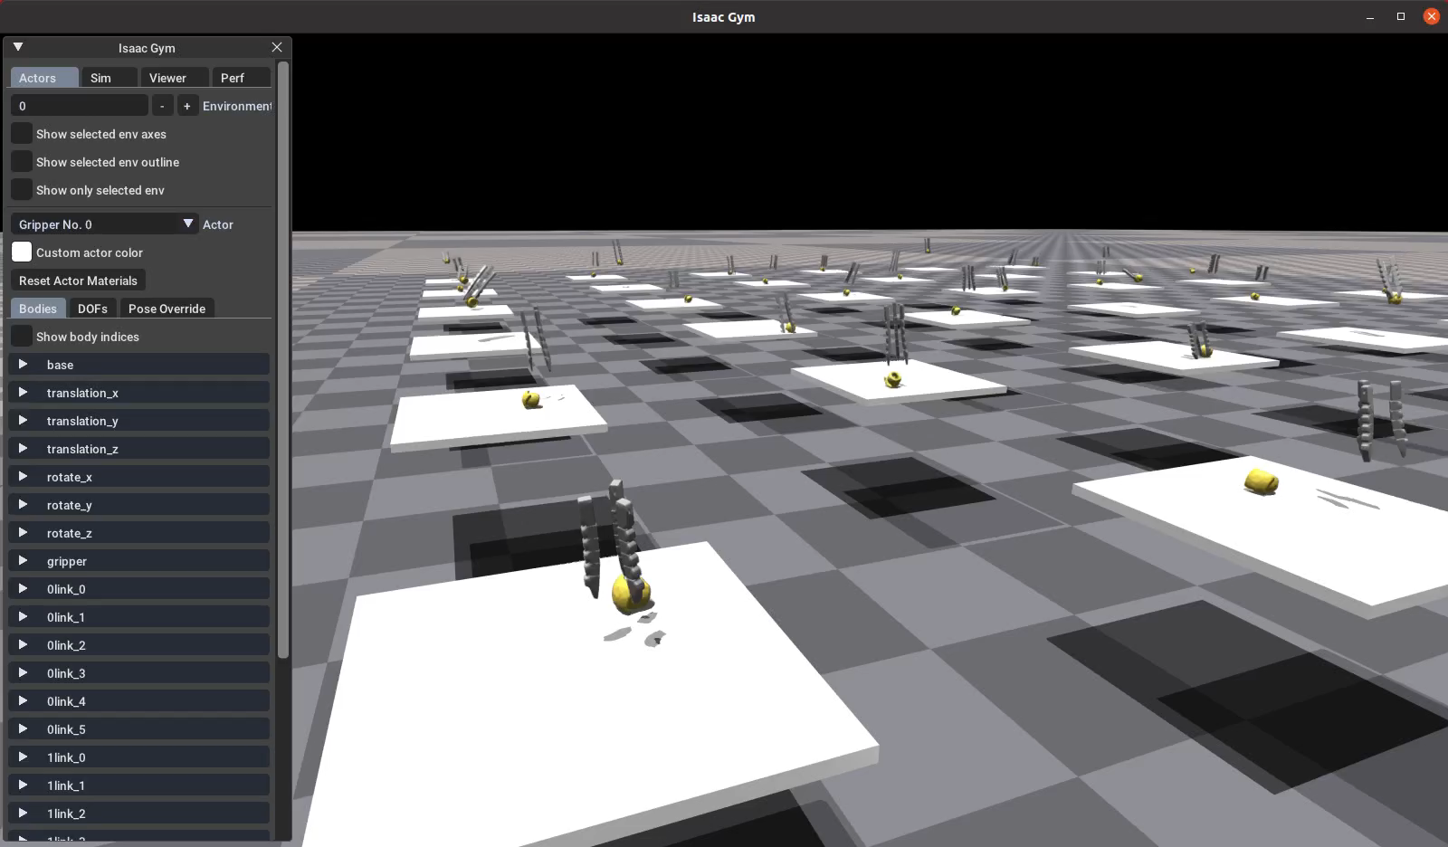
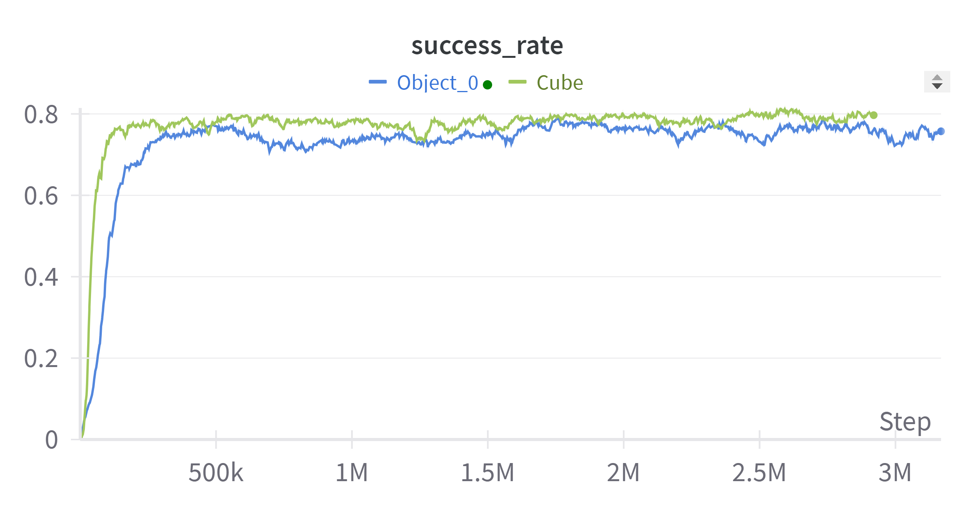
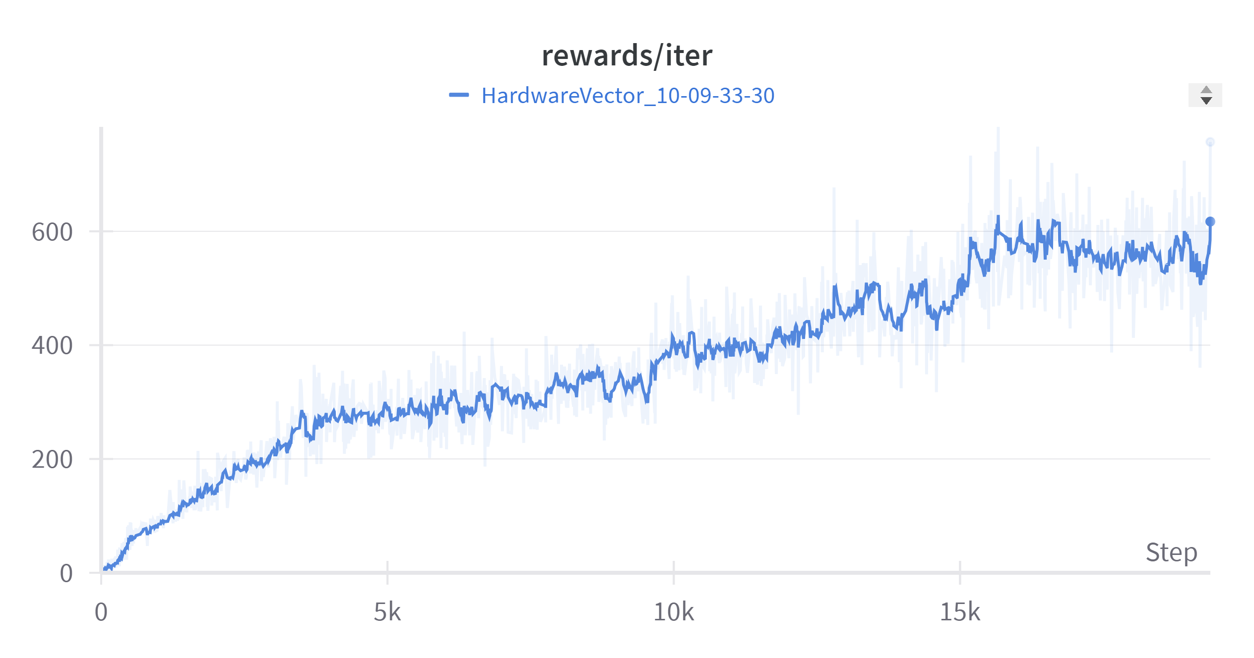
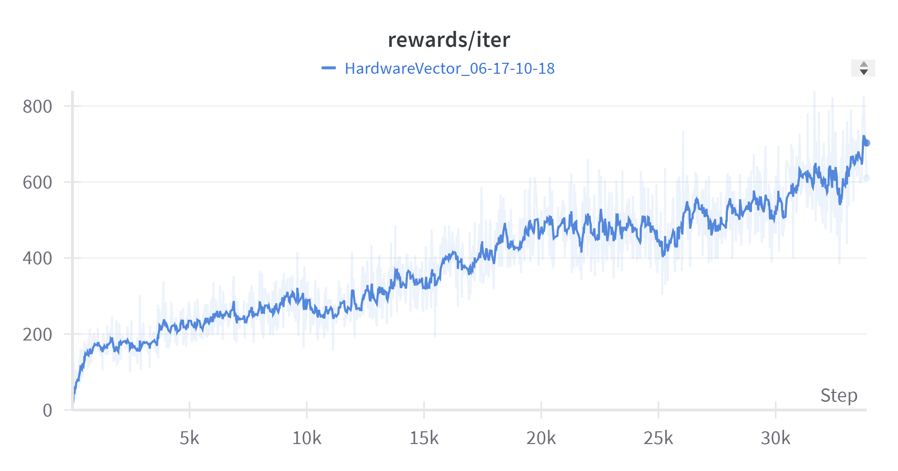
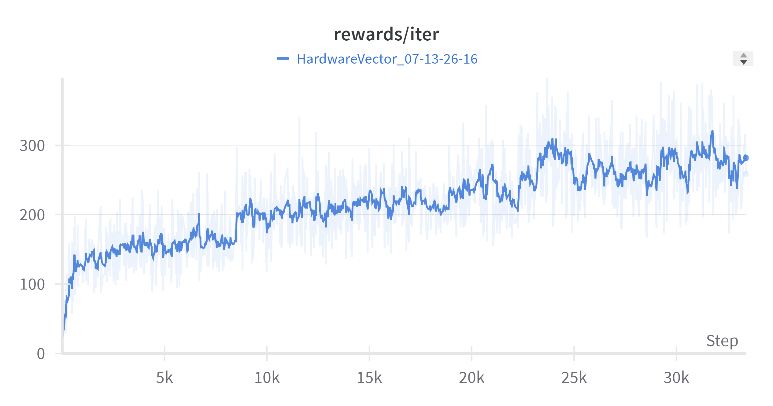
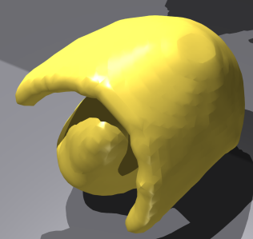
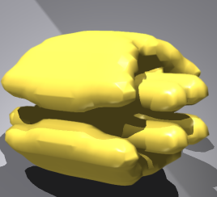
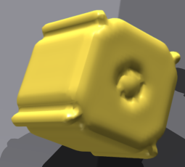
Performance on different objects
Performance of training the gripper to grasp other objects with different shapes
- Load different types of finger configuration into each environment: from 2 to 5-fingered gripper
Performance
object_0
object_1
object_2

Slide 7
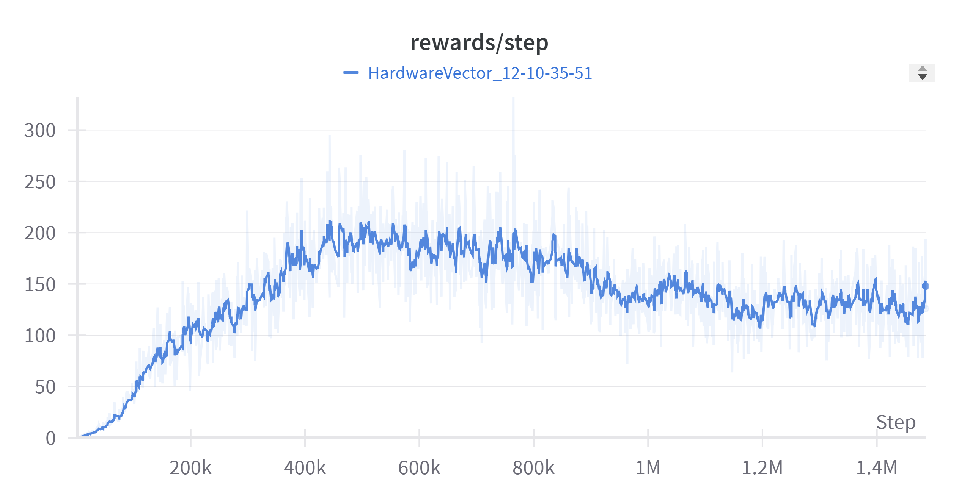
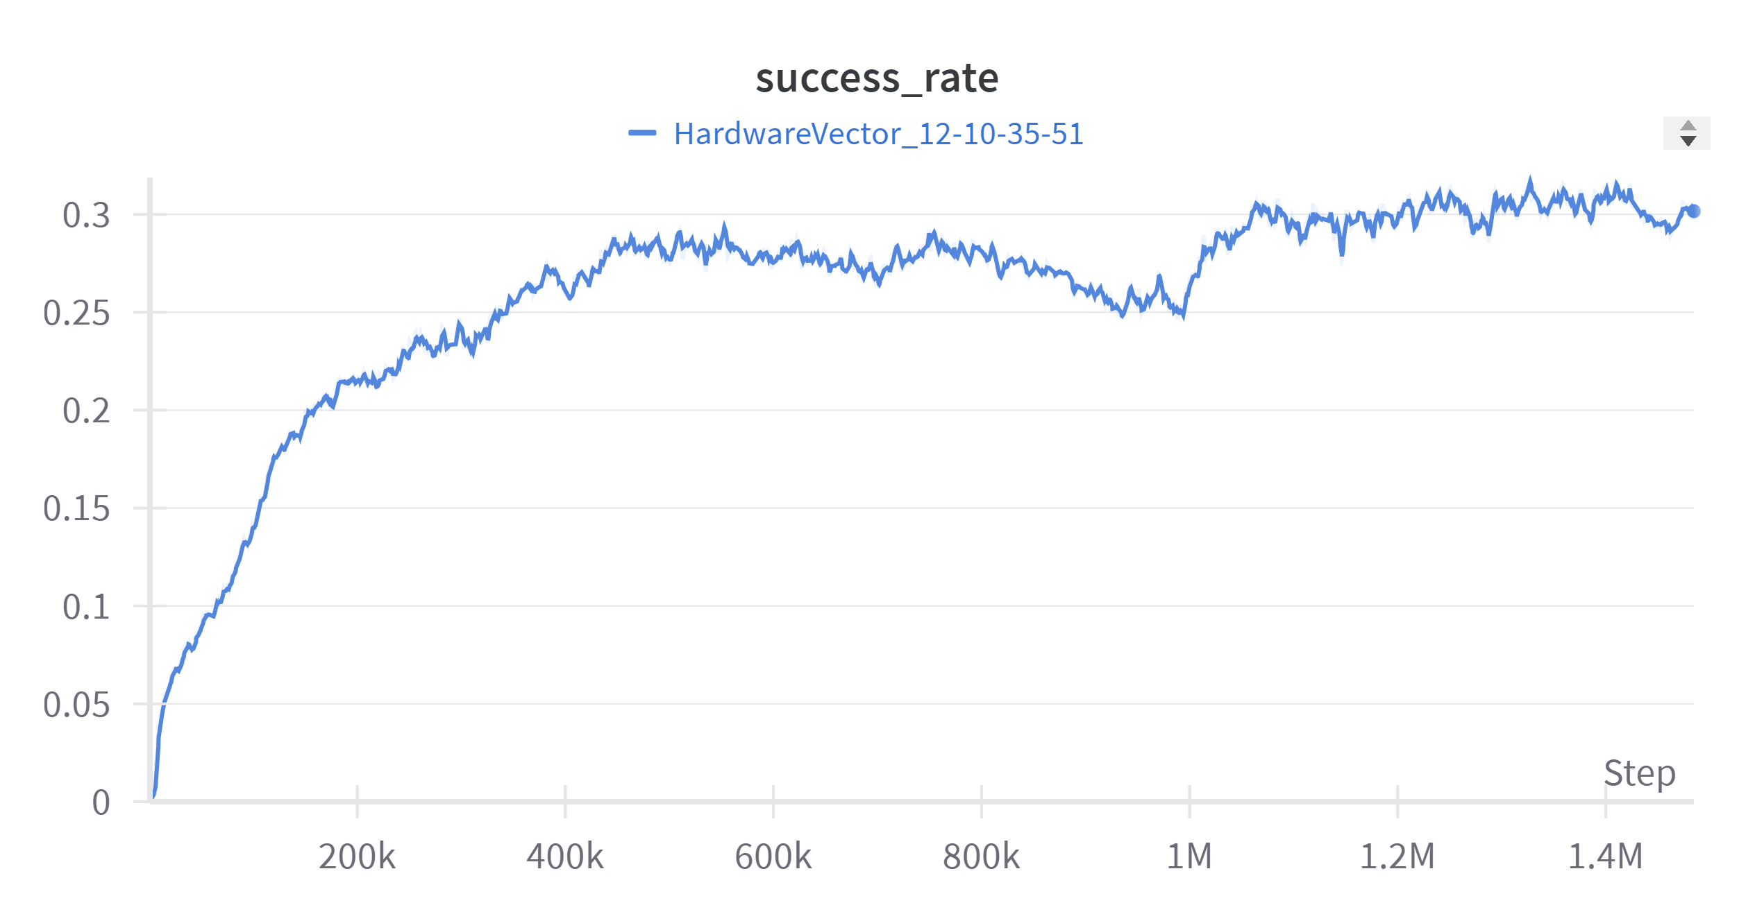
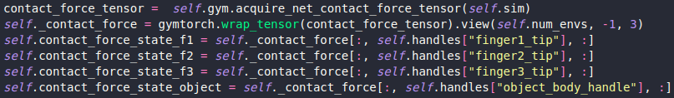
Performance on different objects
Learning curve for grasping multiple objects at the same time
Attempts:
- Adding contact force between fingers and object
→ How to detect if the gripper is in contact with the object?

Slide 8
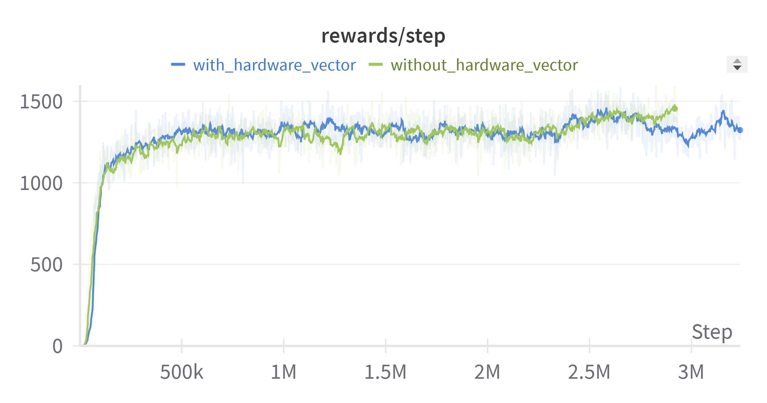
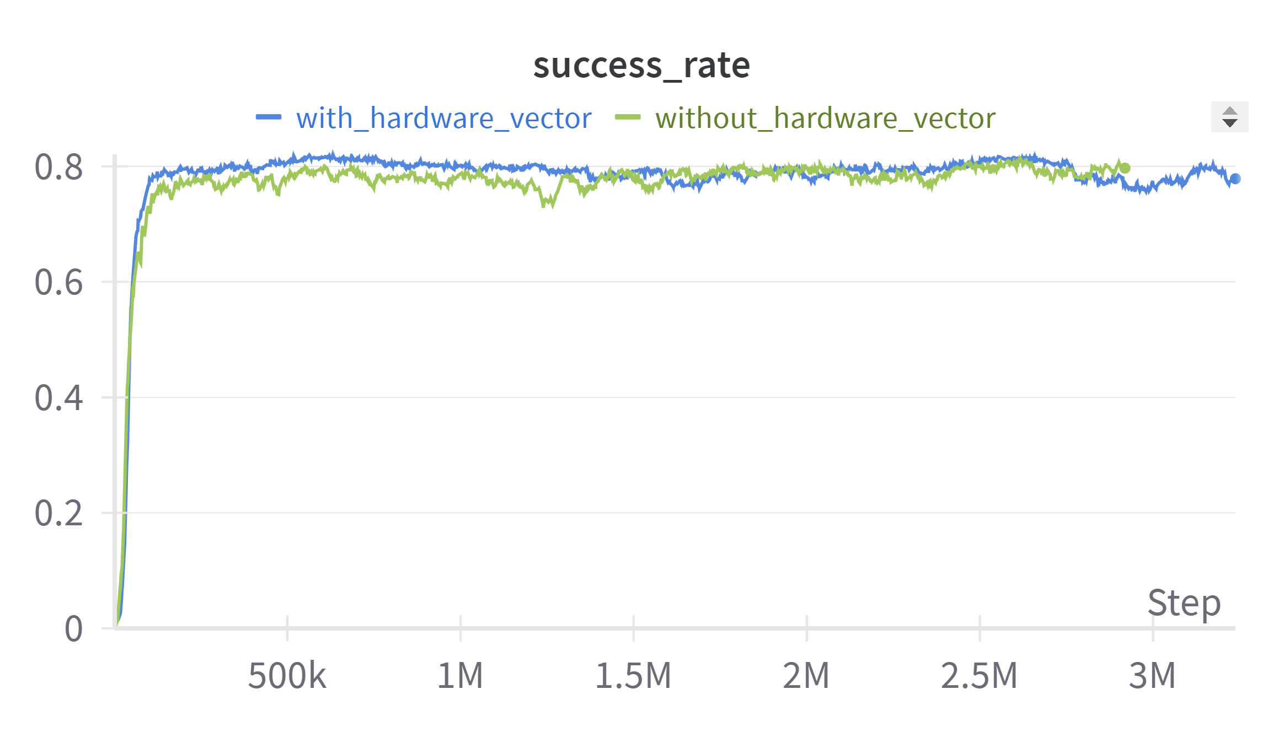


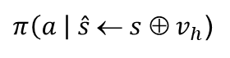
Different scale of grippers
Update on constructing hardware vector
(self._q[:, 10]-self._q[:, 9])
Hardware vector $v_{h}:$ relative distance $d_{i}$ between 2 last joints of each finger
$$$$
(self._q[:, 15]-self._q[:, 14])
+ Similar rates of convergence in terms of reward and success rate
→ The hardware vector has little effect on learning curve
(self._q[:, 20]-self._q[:, 19])
$π\left(a \right| \hat{s} ← s ⊕ v_{h}$)

Slide 9
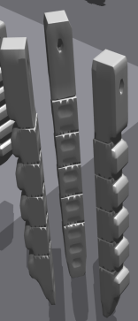
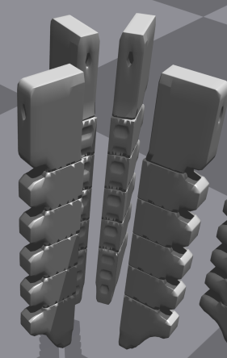
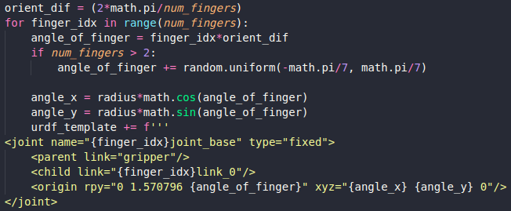
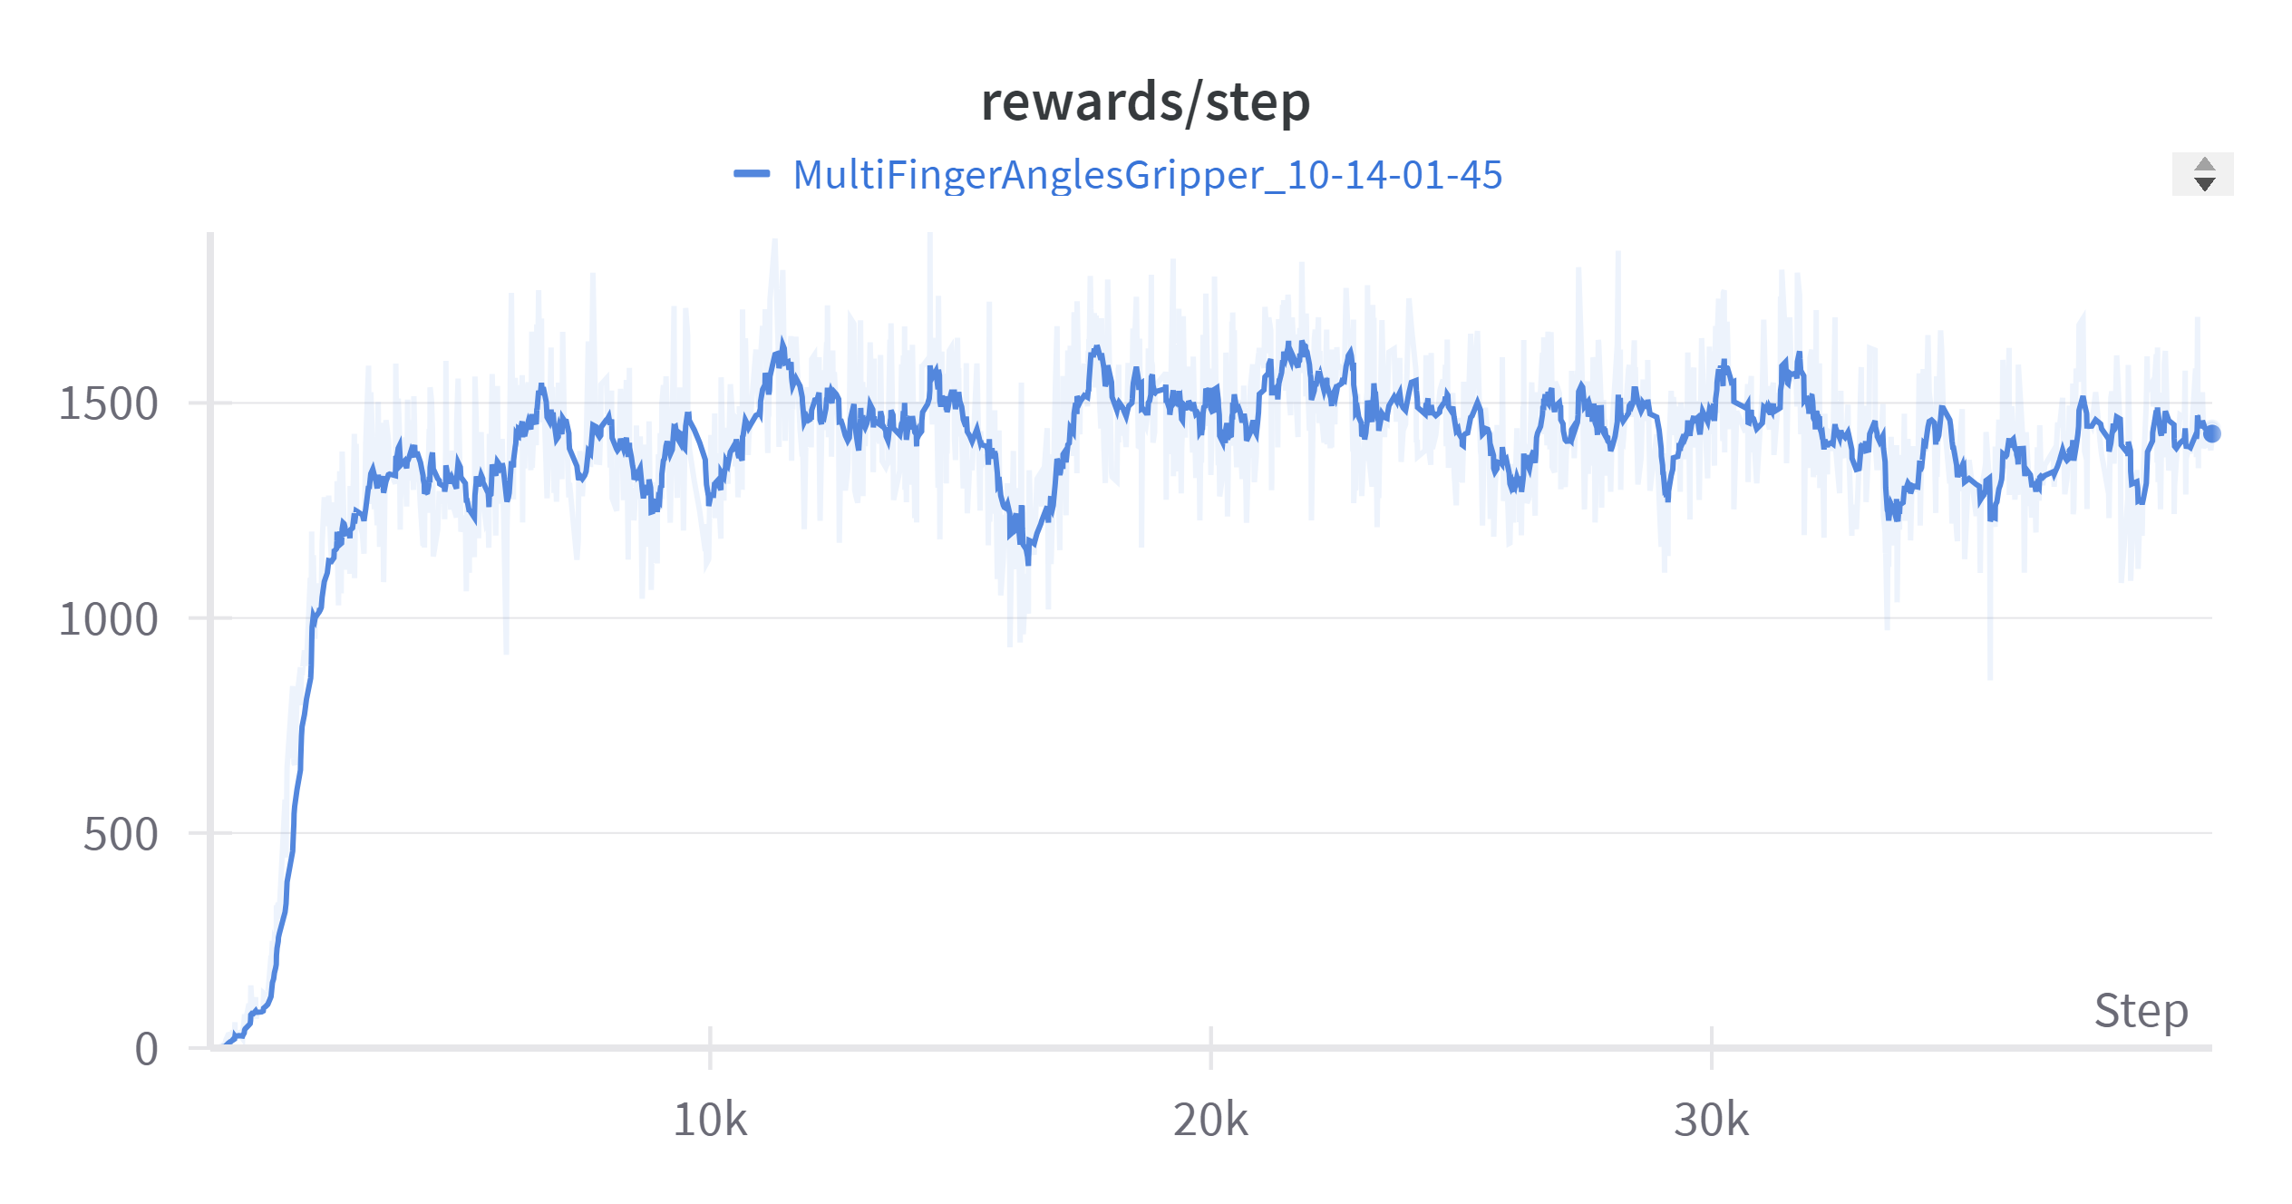
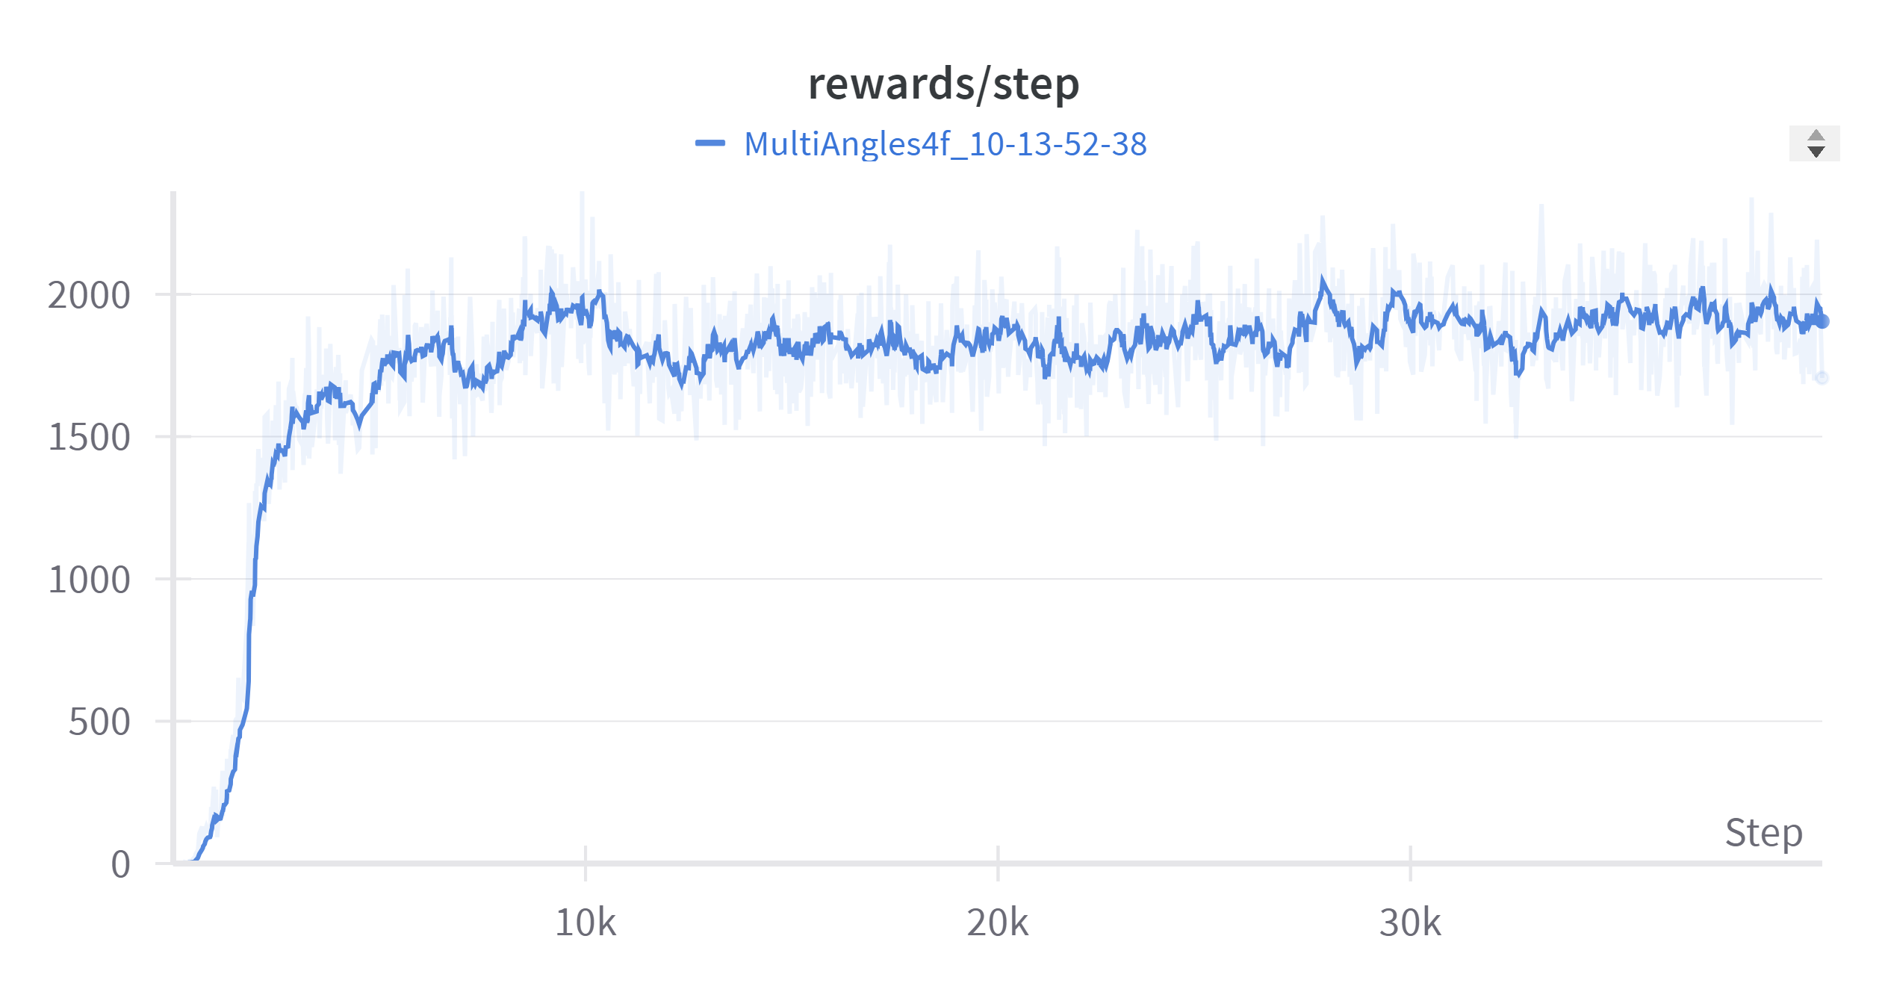
Different finger orientation
- Varying the angles between fingers of the gripper
2-fingered gripper
3-fingered gripper
5-fingered gripper
4-fingered gripper

Slide 10
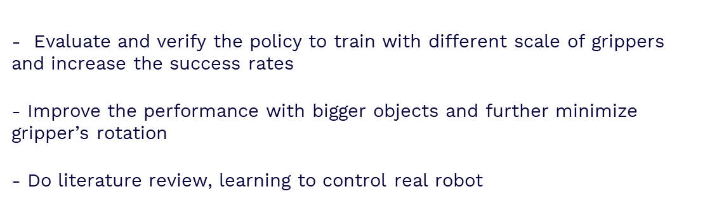
Future work
- Evaluate and verify the policy to train with different scale of grippers and increase the success rates
- Improve the performance with bigger objects and further minimize gripper’s rotation
- Do literature review, learning to control real robot

Slide 11
Thanks!

